Slide 1

HR Attrition Data Analysis
Prepared by 5th batch.
20 May 2023

Slide 2

Overview: As per the data 50,000 employees in organization 50% of males and 50% of females. We are using different types of categories to analyze the data and find out the wrong and Ratifications. How different departments are affected while employees get attired. How financial status will be affected. And work life balance will be explained through this HR data analysis.
Methodology:
The Research conducted a quantitative analysis on data set gotten from EXCELR.

Slide 3

Analysis: We analyze the data depending on the 6 categories. 1.Average Attrition rate for all Departments 2.Average Hourly rate of Male Research Scientist 3.Attrition rate Vs Monthly income stats 4.Average working years for each Department 5.Job Role Vs Work life balance 6.Attrition rate Vs Year since last promotion relation

Slide 4

Tools:
While explaining HR Attrition data analysis, we use below 4 tools.
1.Excel
2.SQL.
3. Tableau
4.Powerbi.

Slide 5

Introduction of data
Total Employees 50,000
Current Employee 49.79%
24,895
Ex-Employees
50.21%
25,105
Number of Department
6
Number of Job Roles:
10

Slide 6
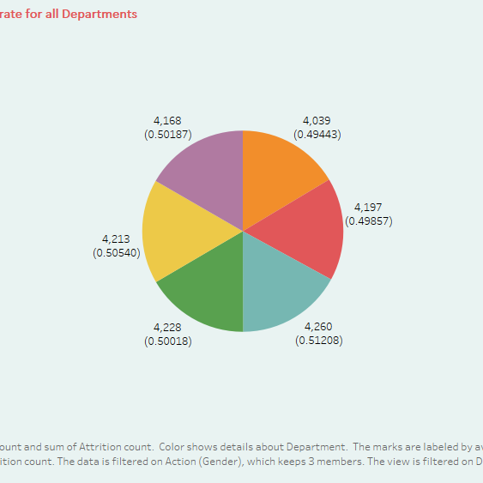
Average Attrition rate for all Departments
We observe all the departments have an equal ratio of attraction. So, we need Take an immediate action to retain the employees in every department.
Tableau

Slide 7

Average Hourly rate of Male Research Scientist
select avg(hourlyrate) from hrprojwhere hrproj.gender='male' and hrproj.jobrole='Research Scientist';
Average hourly rate of male Research Scientist
115 1,46,777
Average hourly late for male research scientists at 115 and female research scientists also working at the simultaneously 114.
SQL

Slide 8
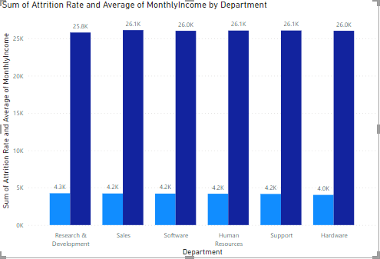

Attrition rate Vs Monthly income stats
We see that more attraction in sales department and also simultaneously the monthly income is high in sales only.
POWERBI

Slide 9

Average working years for each Department
As per the data software Developers of working years are very high and research scientists working years low.
EXCEL

Slide 10
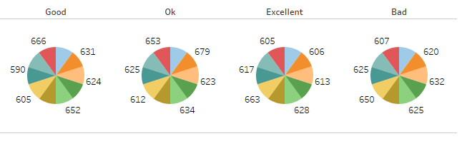

Job Role Vs Work life balance
When we see the data BAD % work life balance of the employees somewhat HIGH. So, we need to conduct programs, how to balance work life and personal life. This will be a creative impact in attritions.
Tableau

Slide 11

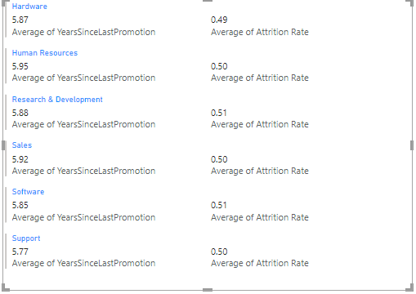

Attrition rate Vs Year since last promotion relation
We observe that every department minimum 5 plus years of promotions and 0.5% of the attrition in each department. For this, we need to concentrate each department for the promotions and hikes. For this attrition rate will be decreased.
POWERBI

Slide 12

Conclusion:
We observe that every department has attrition. It is depending on work life, job roles, Age, gender, distance, promotions, and hikes. So, we need to give a promotion and hikes depending on their working style. In this way we will come down the attraction rate.
We need to concentrate on sales department because the salespeople change quickly, and high income also stuck in sales department. So, we need to take some changes.
Take some advice from the seniors and conduct refreshment sessions. We will provide the launch and take out from the city.
Conducting the new programs, giving a new opportunity to develop them. To create awareness of how to balance work life and personal life.
To provide a transport facility to the employees and distance will be impact for the attrition.
Don’t show a gender variation and age variation.
This way, we will encourage every employee, attraction rate will be a decrease. We can retain the employees in the organization.

